Slide 1
The Fourteenth Amendment to the U.S. Constitution
United States Constitution The 14th Amendment
Equal Protection Under the Law

Slide 2
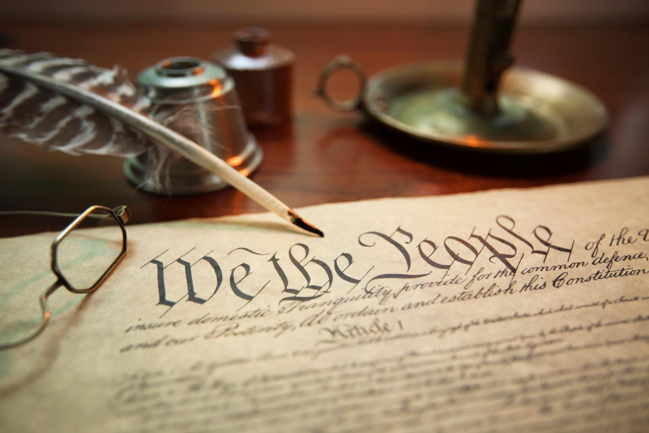
Constitution Day September 17
Constitution Day reminds us of our important protections and rights under law.
Notes:
Under the laws created and voted upon by the people of the United States of America.

Slide 3
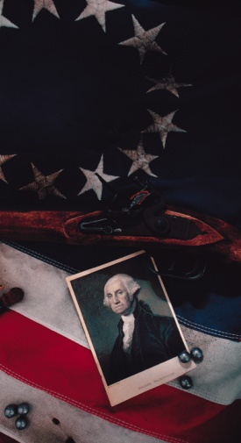
The Constitution: Was drafted by America’s founders as the fundamental law of the nation. Was intended to organize the government and define the rights and responsibilities of citizens and elected representatives. Guarantees justice and equality under the law for all Americans. James Madison drafted the Bill of Rights (the first 10 amendments) in 1789 and they were adopted in 1791.

Slide 4
“[N]o state shall make or enforce any law . . . which shall deprive any person of life, liberty, or property ... nor deny to any person within its jurisdiction the equal protection of the laws.”
The Fourteenth Amendment States:

Slide 5
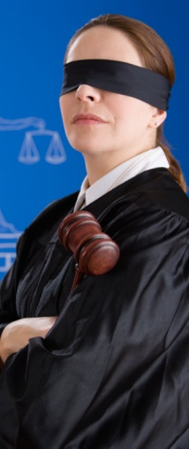
The Fourteenth Amendment guarantees the right to equal protection under the law.
The amendment restricts the government; not private individuals/groups.
What are some examples of characteristics of people that has resulted in disparate (unequal) treatment by the government?
Race;
Ethnicity;
Gender (gender orientation, identification etc);
Citizenship
Residency

Slide 6
“Individual right to equal treatment”
must be balanced against the President’s Constitutional duty to protect the security
of the country as a whole.

Slide 7
Article II, Sections 2 & 3 of the Constitution state:“The President shall be Commander in Chief of the Army and Navy of the United States, and the militia of the several states when they are called into the service of the United States . . and [the President] shall take care that the laws be faithfully executed.”

Slide 8
The president is the leader of the “Executive Branch.” Name the other 2 branches. Why have 3?
A purpose of the executive branch to enforce the law;
Sections 2 & 3 allows the President taking sweeping action to carry out the law;
Allows the President (Commander in Chief) to issue Executive Orders having the force of law - until Congress passes conflicting law or court rescinds the Order

Slide 9
14th Amendment V. Executive Power

Slide 10
Fred K. v Midwestia
Midwestia is a beautiful country, rich in resources and populated by people who emigrated from other countries over many generations. Midwestian citizens treat one another as equals under their Constitution and other laws. They elect their leaders through a democratic process. The majority of the citizens are grateful for the freedoms they enjoy and their “enlightened” way of life.

Slide 11
Fred K. v Midwestia
Midwestians hail from many cultural backgrounds that they proudly and openly honor in their free country. The vast majority of citizens are descendants of Wolverines or Spartans, but some are of Hawkeye descent. Others have Boiler Maker blood from 100 years ago. Still others are descended of the Gophers and the Wild Cats.

Slide 12
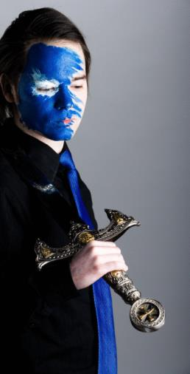
Fred K. v Midwestia
About 200,000 Midwestians come from descendants of Badgers who once lived in the Badger nation to the north.
Since arriving in Midwestia 200 years ago, Midwestians managed to put aside deep cultural rivalries and live together in peace and harmony until three months ago, when Midwestia was viciously attacked by the Badger nation to the north. It was a surprise attack, and many Midwestians were brutally killed. The Badgers are powerful and have vowed to continue their maniacal destruction of Midwestia. Midwestian government does not know yet whether the attack was an “inside job” or whether it emanated from the Badger nation to the north.

Slide 13
Fred K. v Midwestia
Citizens of Midwestia are shocked, angry and frightened. They believe that all they have worked for is at risk, and their own family’s lives are in danger.

Slide 14
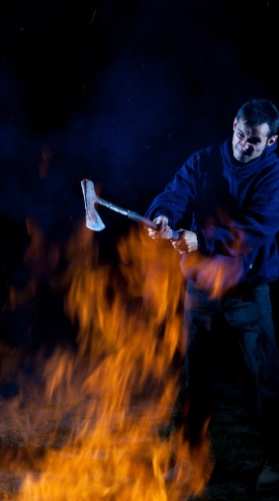
Fred K. v Midwestia
Midwestia’s President declared war immediately and instructed the military to attack the Badger nation with all possible force.
Midwestians have become increasingly suspicious of their friends, neighbors and classmates whose ancestors hail from the Badger nation. They fear these people will be sympathetic to the Badger nation and become traitors. They are even worried that some of them might have had something to do with the attack.

Slide 15
Meanwhile, many Badger-Midwestians feel like everyone is watching them and suspecting them when they have done nothing to deserve it except have a great grandparent from another land that happens to be attacking their own country.

Slide 16
Fred K. v Midwestia
In the midst of the increasing fear and suspicion of Badger-Midwestians, the President signed Executive Order “Operation Safe” requiring all 200,000 Midwestians of Badger heritage to voluntarily relocate to military camps where they will be confined and watched until the conflict with the Badgers ends.

Slide 17
Fred K. v Midwestia
Military officials are ordered to arrest any citizen of Badger heritage who does not voluntarily move to the camps.
Fred K. was born in Midwestia. His parents moved to Midwestia from the Badger nation as children. Fred is 35 years old and works in a bicycle factory in Midwestia’s largest industrial city.

Slide 18
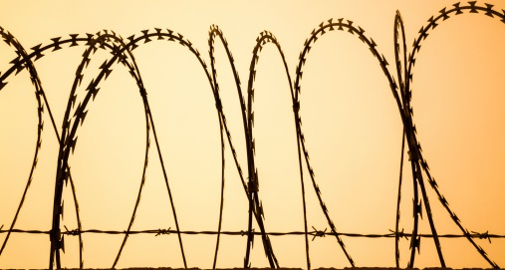
Fred K. v Midwestia
Fred decided he would not willingly go to a military camp as ordered by the President because he is not a traitor and needs to work in order to provide food for his wife, who is of Wolverine descent, and his children, who are part Badger and part Wolverine.

Slide 19
Fred K. v Midwestia
Fred was arrested last week and put in jail because of his refusal to go to the military camp. He and his part-Badger children will be moved to a nearby camp soon against his will.
DISCRIMINATION
noun dis·crim·i·na·tion \
dis-ˌkri-mə-ˈnā-shən\
the practice of unfairly treating a person or group of people differently from other people or groups of people

Slide 20
Fred K. v Midwestia
What should the president do?
Military
Cabinet
State Department
Media(traditional outlets)
Internet(anyone on social media)

Slide 21
Fred K. v Midwestia
Who might hold opposing views to Fred’s?
Congressional Public Policy Committee on National Security
Midwestia Military and Defense Department Task Force

Slide 22
Fred K. v Midwestia
Who will help Fred?
Fred’s Wolverine wife has notified the Midwestian Constitutional Rights Organization (MCRO), a non-profit agency staffed by recent graduates of Midwestia Law School and charged with protecting the citizens’ rights under the Midwestia Constitution, about Fred’s plight.

Slide 23
Fred K. v Midwestia
Is there a volunteer
to represent Fred?
MCRO has agreed to represent Fred in a lawsuit against the Midwestian government to release him under the 14th amendment of Midwestia’s Constitution. MCRO will argue that Fred has been unfairly discriminated against and denied equal protection under the law guaranteed by the 14th Amendment.

Slide 24
Fred K. v Midwestia
Who else might have an
interest in Fred’s cause?
National Association for the Advancement of Badger-Midwestians

Slide 25
Fred K. v Midwestia
Everyone in Midwestia is talking about the case and expressing conflicting opinions. The National Press Association is convening a panel discussion this evening at 9:00 p.m. It will be broadcast to the entire nation and all regular programming will be pre-empted.
The President of Midwestia and key members of Congress will be watching and listening. Members of each group below will participate in the panel discussion:

Slide 26
You will divide into these 4 groups to prepare for the press conference, and designate one student/group to sit on the panel, but first, you need to know Midwestian LAW.

Slide 27
Let’s review the Law

Slide 28
Midwestian Law
Article 5, Section 1 of the Midwestia Constitution states:
“No person within Midwestia shall be denied equal protection of the law.”
What does “equal protection of the law mean”?

Slide 29
Midwestian Law
The Midwestia Supreme Court defined “equal protection of the law” in Blue v Board of Education:
Equal protection of the law means that our nation’s laws must treat all persons equally unless there is some very important reason to treat people differently. If the government wants to treat some people differently because of the ancestors came from a particular place, then the government must prove two things:

Slide 30
Midwestian Law
First, the government must prove that there is an ‘extremely important purpose’ for treating some people differently than others.

Slide 31
Midwestian Law
Second, the government must prove that no other way to achieve this extremely important purpose exists that is ‘less restrictive of freedom.’

Slide 32
Midwestian Law
If we look at all of the facts in a particular situation and conclude that the government has failed to prove either one of these things, then the government’s action is unconstitutional.

Slide 33
Article 2, Section 3 of the Midwestia Constitution states:
“The President shall be the chief officer in charge of protecting the national security of Midwestia.”
The Midwestia Supreme Court said in Bin Lawless v U.S.
When the President is acting to protect national security, the President has the authority to issue Executive Orders. … Whether Executive Orders comply with the Midwestia Constitution is a question for the Supreme Court to decide.

Slide 34
Prepare for your press conference

Slide 35
Hold your
press conference

Slide 36
DID THIS REALLY HAPPEN?
Notes:
https://www.michbar.org/programs/milestone/milestones_murphysdissent
http://www.pbs.org/wnet/supremecourt/personality/landmark_korematsu.html

Slide 37
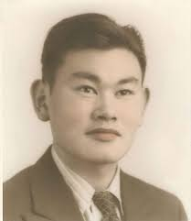
Korematsu v United States (1944)
The Case of Fred K. v Midwestia is based on the actual United States Supreme Court case, Korematsu v United States (1944). Fred Korematsu refused to relocate to an internment camp under President Roosevelt’s Executive Order to relocate 120,000 Japanese Americans to military camps during World War II.
Fred Korematsu sued the United States to challenge his internment. He was convicted of violating the President’s Executive Order; he was sentenced to 5 years probation and was forced to relocate to an internment camp. His case went to the United States Supreme Court in 1944 and the majority upheld his conviction in the lower courts. United States Supreme Court Justice Frank Murphy, a Michigan native, wrote a stinging dissent to the majority opinion stating that all Americans are guaranteed equal protection under the law and freedom from unfair discrimination.
Notes:
https://www.michbar.org/programs/milestone/milestones_murphysdissent
http://www.pbs.org/wnet/supremecourt/personality/landmark_korematsu.html

Slide 38
(From Wikipedia):
Korematsu v. United States, 323 U.S. 214 (1944), was a landmark United States Supreme Court case concerning the constitutionality of Executive Order 9066, which ordered Japanese Americans into internment camps during World War II regardless of citizenship.
Some say it was the worst decision in United States history. 6 Justices voted for and 3 against the internment camps. The opinion, written by Supreme Court justice Hugo Black, held that the need to protect against espionage outweighed Fred Korematsu's individual rights, and the rights of Americans of Japanese descent.

Slide 39
The Korematsu decision has not been explicitly overturned, although in 2011 the Department of Justice filed official notice, conceding that it was in error, thus erasing the case's value as precedent for interning citizens.
However, the Court's opinion remains significant both for being the first instance of the Supreme Court applying the strict scrutiny standard to racial discrimination by the government and for being one of only a handful of cases in which the Court held that the government met that standard.

