Slide 1
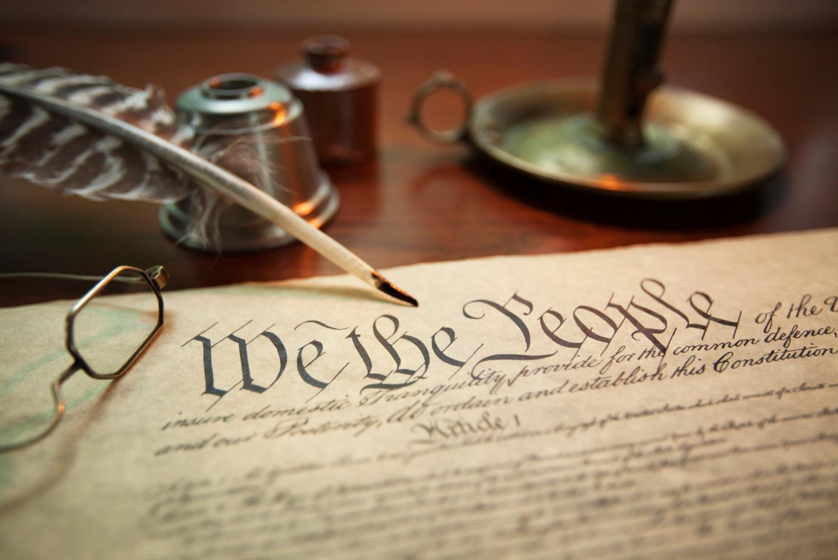
Constitution Day September 17
Constitution Day reminds us of our important protections and rights under law.
Notes:
Under the laws created and voted upon by the people of the United States of America.

Slide 2
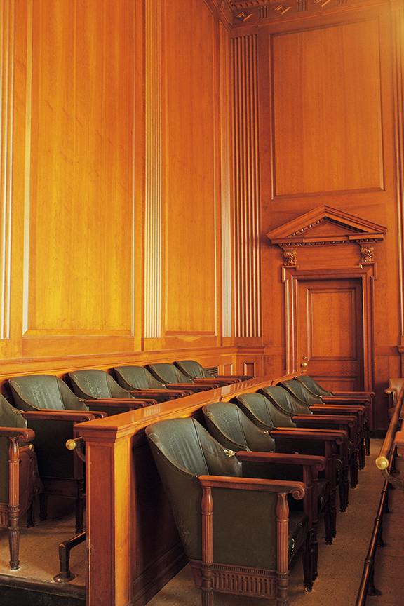
Trial by Jury
United States Constitution The 6th Amendment

Slide 3
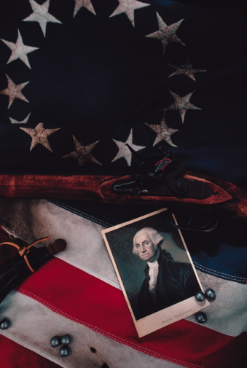
The Constitution was drafted in 1787 after the Revolutionary War.
Notes:
In Colonial America, citizens believed their rights were violated under English Rule. The Constitution was drafted in 1787 after the Revolutionary War. American citizens wanted protections for individual rights included in the Constitution.

Slide 4
Who were the authors of the Constitution?
Who was the “father” of the Constitution?
James Madison
Notes:
James Madison

Slide 5
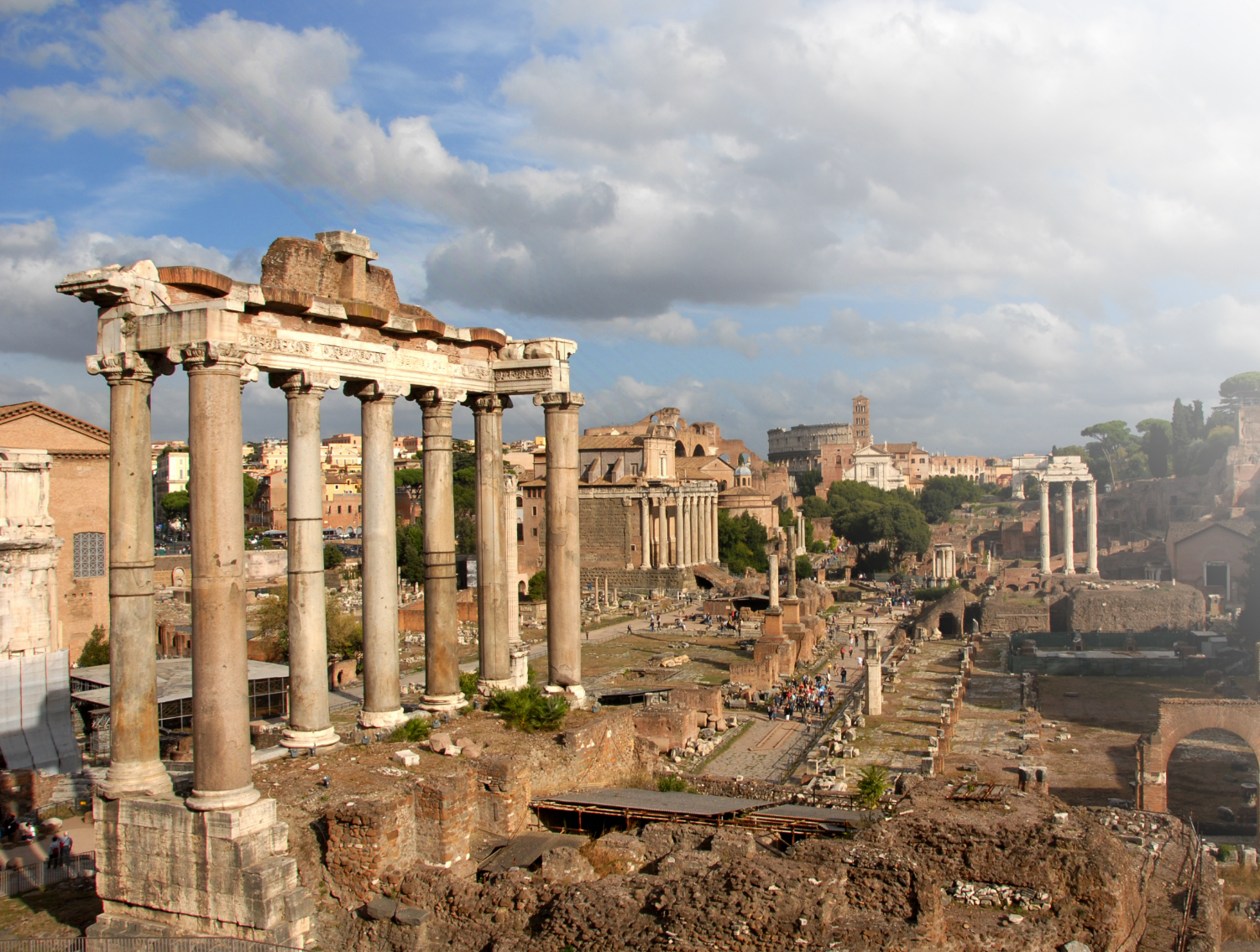
The authors based the Constitution on principles and traditions dating back to Roman times (c. 439 BC).
Notes:
The Forum in Rome Italy. The authors based the Constitution on principles and traditions dating back to Roman times (____AD). Roman law is the legal system of ancient Rome, and the legal developments which occurred before the 7th century AD - when the RomanÐByzantine state adopted Greek as the language of government. The development of Roman law comprises more than a thousand years of jurisprudence - from the Twelve Tables (c. 439 BC) to the Corpus Juris Civilis (AD 529) ordered by Emperor Justinian I. This Roman law, the Justinian Code, was effective in the Eastern Roman (Byzantine) Empire (331-1453), and also served as a basis for legal practice in continental Europe, as well as in Ethiopia, and most former colonies of European nations, including Latin America.
Historically, "Roman law" also denotes the legal system applied in most of Western Europe, until the end of the 18th century. In Germany, Roman law practice remained longer, having been the Holy Roman Empire (963-1806); thus the great influence upon the civil law systems in Europe. Moreover, the English and North American Common law also were influenced by Roman law, notably in the Latinate legal glossary - stare decisis, culpa in contrahendo, pacta sunt servanda. In contrast, Eastern Europe, though influenced by the Byzantine Empire, was not much influenced by the jurisprudence of the Corpus Juris Civilis; however, they did accept the Roman influence of the Farmer's Law. http://www.crystalinks.com/romelaw.html39

Slide 6
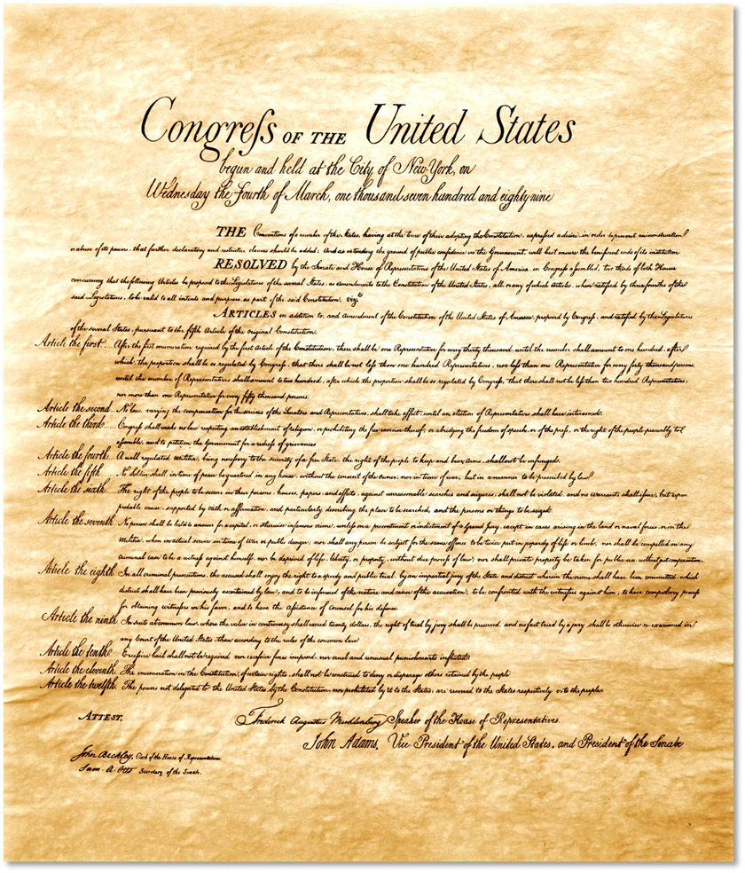
How times has the Constitution been amended?
27 times.
What do we call the first 10 amendments?
The Bill of Rights.
Notes:
The Bill of Rights

Slide 7
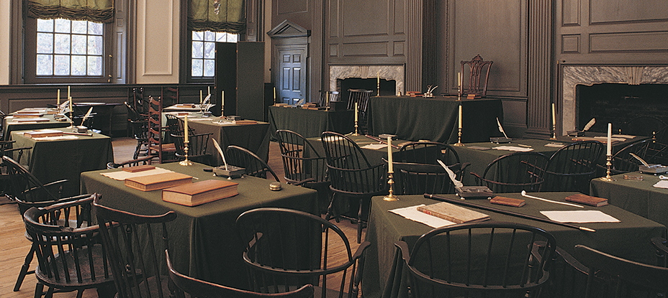
What rights do the Sixth Amendment provide?
Notes:
Constitution Hall, Philadelphia, PA. The room where the founders met and worked on drafting the constitution.

Slide 8
The Sixth Amendment States:
“In all criminal prosecutions,
the accused person shall have the right to a speedy and public trial,
by an impartial jury of the state where the crime has been committed,
the right to know the crime he or she is accused of,
the right to confront witnesses against him or her,
the right to compel witnesses in his or her favor,
and the right to assistance of defense counsel.”

Slide 9
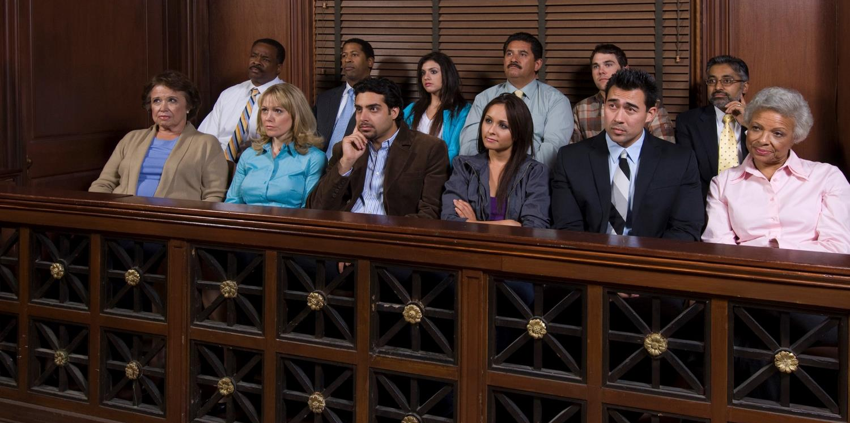
(jury image)
Today We’re Going to Pick a Jury
Notes:
Any citizen can accuse another person of a crime and ask to have the crime investigated and prosecuted by the State. If the State determines that a crime has been committed, the State on behalf of the people represents the victim. Criminal defendants are guaranteed the right to an attorney, and, in some cases, an attorney may be appointed by the court to represent a criminal defendant. Each member is called individually for questioning to determine if he or she is biased for or against the accused.
This process is called voire dire (to speak the truth).
Both sides of a case can remove a juror for no reason until both sides have agreed upon twelve jurors for a criminal trial.
The intent of voire dire is to select an unbiased and impartial jury.

Slide 10
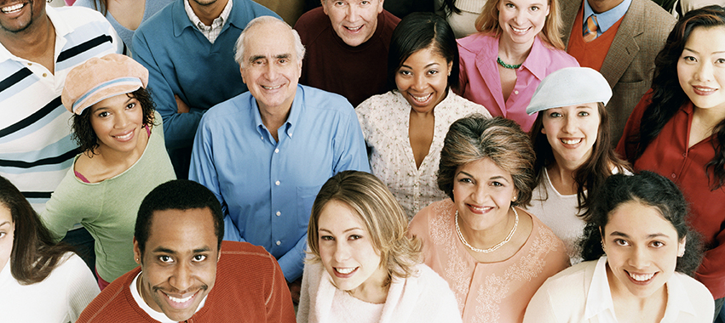
Rules About Jurors
Men and women serve as jurors and must:
Be American citizens
Speak English
Live in the county where the trial is held
Be 18 years of age or older
Have no prior felony convictions.

Slide 11
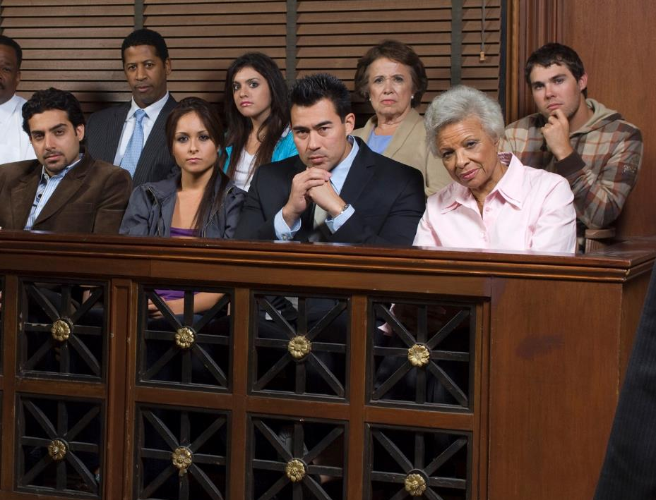
How to Pick a Jury
Jurors are selected randomly from a jury pool.
Voire Dire (to speak the truth) is used to
Check Bias
Pre-emptory Challenges
Challenges for Cause

Slide 12
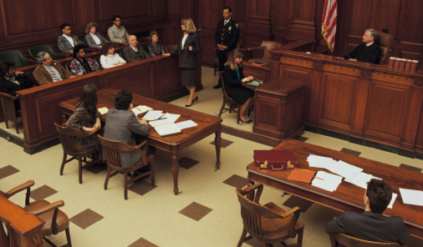
What Jurors Hear
Trials include opening statements, examination and cross examination of witnesses, other evidence such as documents, things from the scene of the crime, fingerprints, samples, video, tape recordings, closing arguments and jury instructions.

Slide 13
All members of the jury must agree on guilt or innocence or the defendant goes free.
Jury verdicts can be appealed.
Notes:
The jury of 12 hears the testimony and considers the evidence presented in the trial case. The judge gives the jury instructions about what each side must prove to the jury, and then the jury considers the evidence in private to reach a verdict.

Slide 14
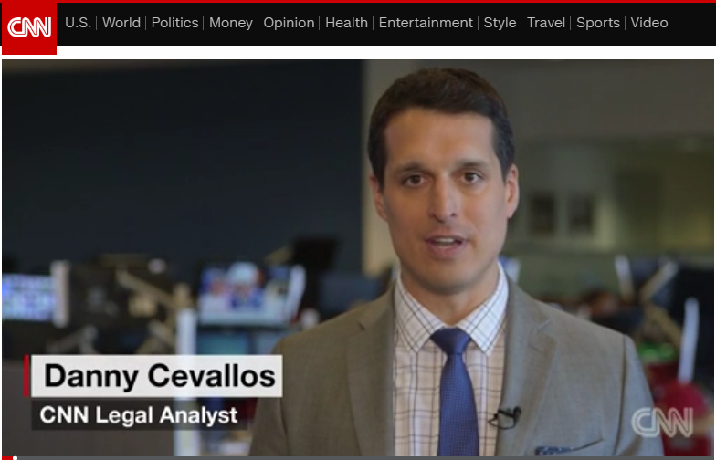
CNN-Jury Trial Selection Video
Jury Selection Video CNN

Slide 15
In Roman Times….
BUT…. Juries in Roman Times were not like juries now.
There were 40-60 jurors.
Only men from the upper classes of society could serve as jurors.
Jurors were chosen by lot.

Slide 16
In Roman Times….
Only a majority vote was required.
Persons found guilty of the crime could not appeal the jury verdict.

Slide 17
Definitions
Jury picked “by lot”
Random
Haphazard
Accidental
Without plan or Design
Jury picked by “voire dire” (To speak the truth)
Questioning to determine suitability and qualifications and to identify bias
Impartiality, neutral, fair, disinterested, objective

Slide 18
STATE OF MICHIANA v ROBIN BIRDSONG
Robin Birdsong is a famous rock star who gives a concert every summer in Tuneville, Michiana. The concert is held in Cherry Hill Park and hundreds of Tuneville residents turn out each year for the event.

Slide 19
STATE OF MICHIANA v ROBIN BIRDSONG
Robin donates the money earned from the concert ticket sales to HELP OUR PETS, (HOP) a local charity that finds homes for unwanted and stray animals.

Slide 20
STATE OF MICHIANA v ROBIN BIRDSONG
Robin spent two weeks in Tuneville last July preparing for the concert. Recently, Robin has been charged by the State of Michiana with breaking into HOP’s offices while he was in town and stealing a large sum of money.

Slide 21
STATE OF MICHIANA v ROBIN BIRDSONG
Robin denies the charges and entered a plea of not guilty with the court. The case is set for trial and jury selection takes place today.

Slide 22
STATE OF MICHIANA v ROBIN BIRDSONG
Robin is protected by the Sixth Amendment to the United States Constitution which guarantees that:
In all criminal prosecutions, the accused person shall have the right to a speedy and public trial, by an impartial jury of the State where the crime has been committed.

Slide 23
STATE OF MICHIANA v ROBIN BIRDSONG
Keeping in mind that Robin is entitled to an impartial jury, review the list of potential jurors in the Jury Pool. Use your best judgment based on the information given about each potential juror to decide whether or not that person would be fair and impartial in hearing Robin’s case. The twelve jurors you choose will decide whether Robin is guilty or not guilty of the crime.

Slide 24
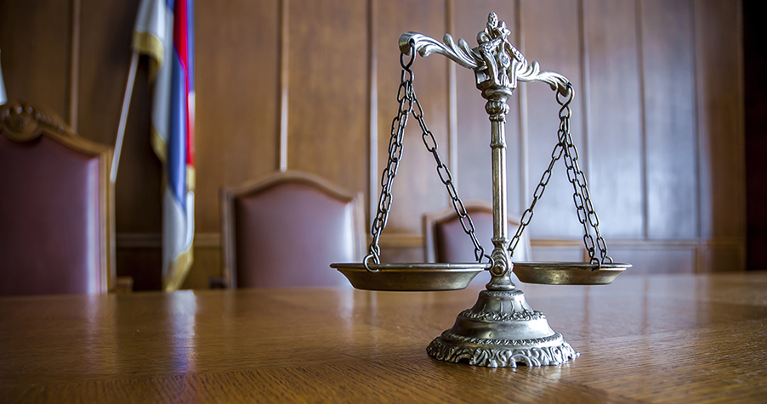
Pick Your Jury Using the Sixth Amendment

Slide 25
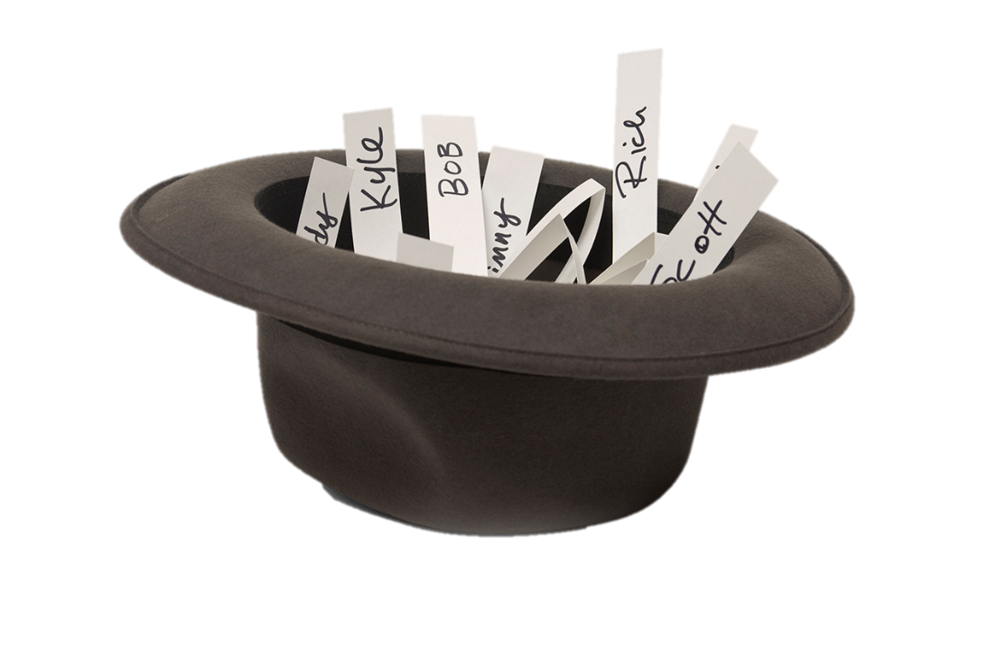
Pick Your Jury by Lot
Did Robin get a fair trial with
the jurors chosen by lot?

Slide 26
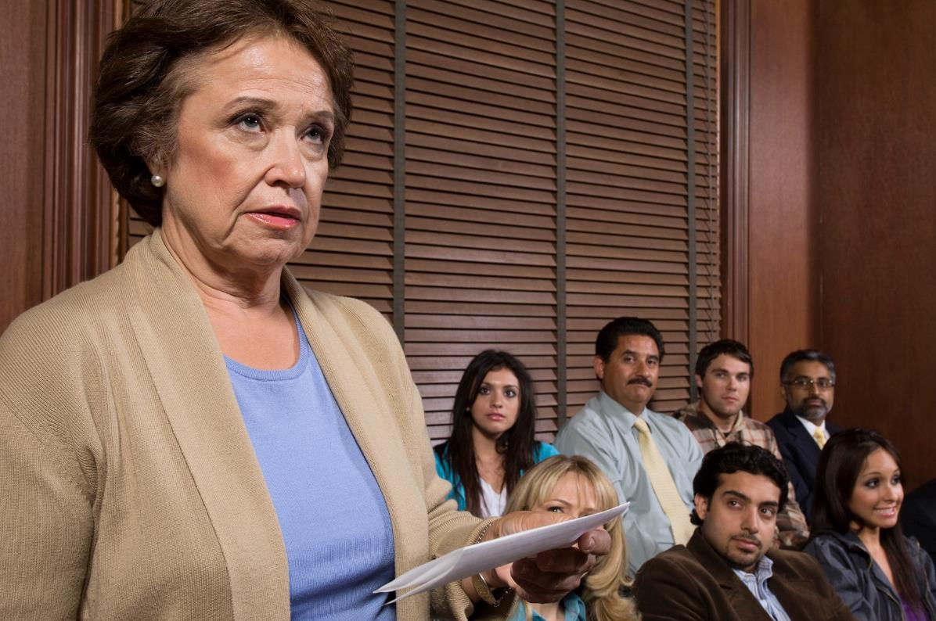
Which Jury is Better?
Is the 6th Amendment a fair process?

